Slide 1
Japanese Internment Photo Analysis Activity
With your partner:
Analyze the picture for at least one minute. Pay close attention to details. Discuss.
Answer corresponding questions on Japanese Internment Photo Analysis handout. Please us complete sentences. Do not write on picture packet.
Return picture packet to my desk when finished answering questions. We will review these as a class.
You have 20 minutes.

Slide 2
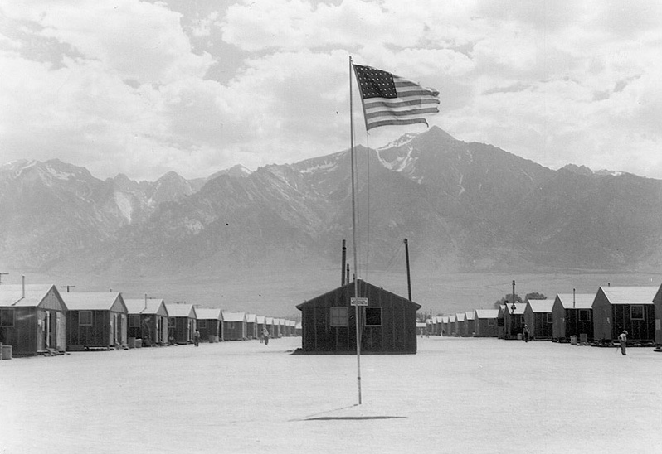
Manzanar Internment Camp in Owens Valley
What are these buildings? Does this look like a nice place to live?

Slide 3
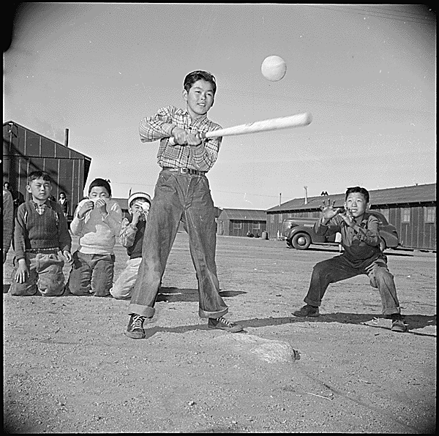
What are these boys doing? Is this a normal activity?

Slide 4
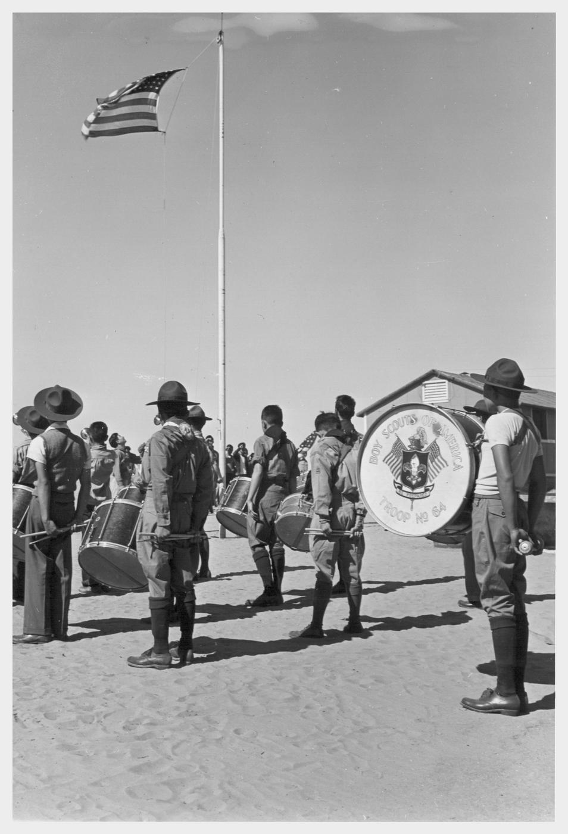
Memorial Day Celebration
Led by Boy Scouts
Why were they celebrating Memorial Day?
Do these people look threatening to you?

Slide 5
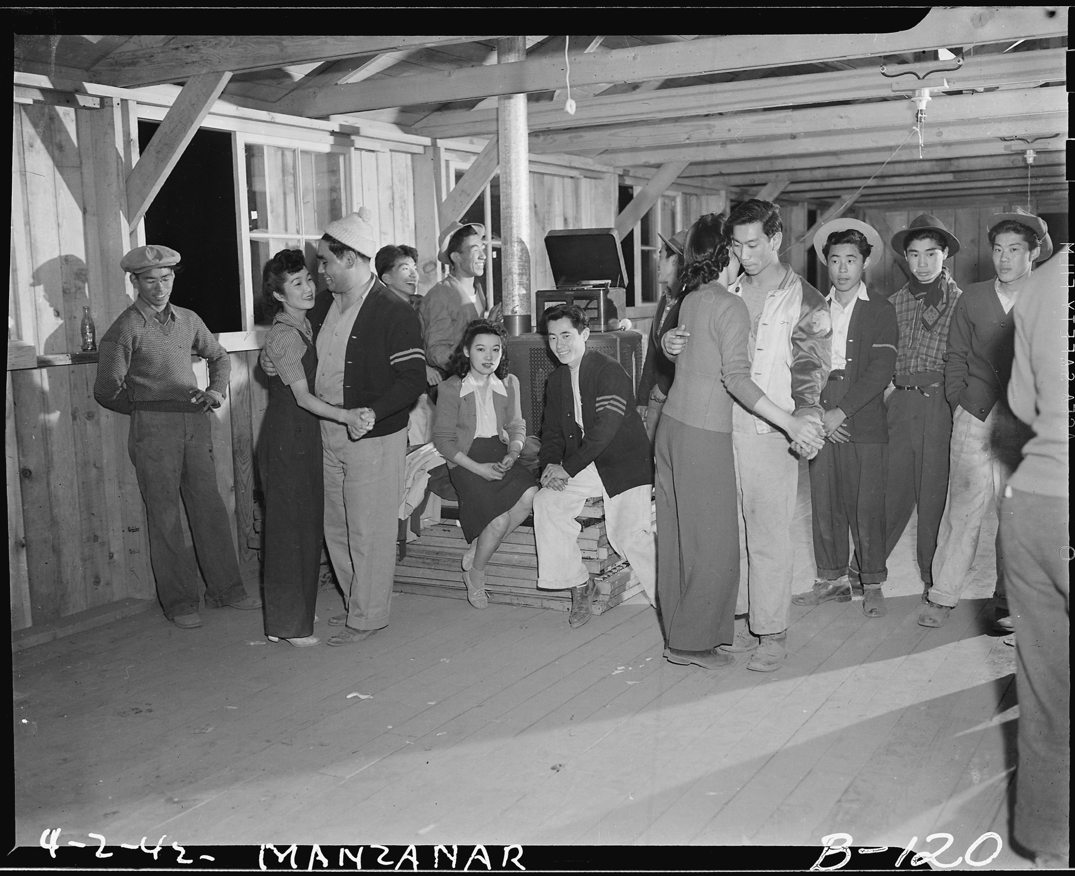
What are these people doing? List three things you notice about these people.

Slide 6
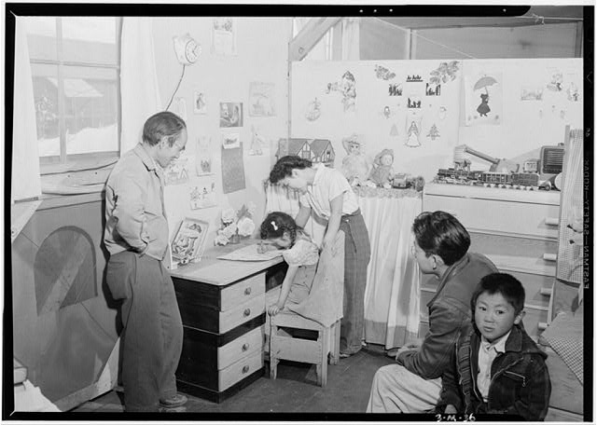
This is a home in the barracks. What do you notice about it? Write down five things that stand out to you?

