Slide 1
1. What symbols (if any) are used in the poster?
2. Is this piece of propaganda from the Axis or Allied side?
3. What is the illustrator trying to motivate people to do or believe? What purpose does this poster serve?
4. The most effective posters use symbols that are unusual, simple, and direct. Is this an effective poster? Why?

Slide 2
1. What symbols (if any) are used in the poster?
2. Is this piece of propaganda from the Axis or Allied side?
3. What is the illustrator trying to motivate people to do or believe? What purpose does this poster serve?
4. The most effective posters use symbols that are unusual, simple, and direct. Is this an effective poster? Why?

Slide 3
1. What symbols (if any) are used in the poster?
2. Is this piece of propaganda from the Axis or Allied side?
3. What is the illustrator trying to motivate people to do or believe? What purpose does this poster serve?
4. The most effective posters use symbols that are unusual, simple, and direct. Is this an effective poster? Why?

Slide 4
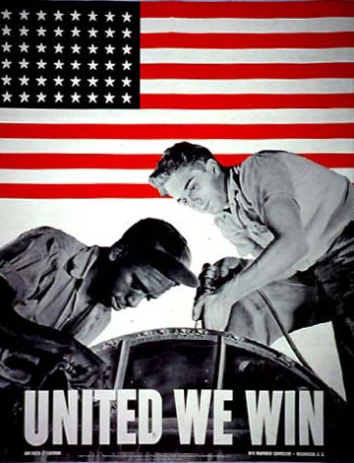
1. What symbols (if any) are used in the poster?
2. Is this piece of propaganda from the Axis or Allied side?
3. What is the illustrator trying to motivate people to do or believe? What purpose does this poster serve?
4. The most effective posters use symbols that are unusual, simple, and direct. Is this an effective poster? Why?

Slide 5
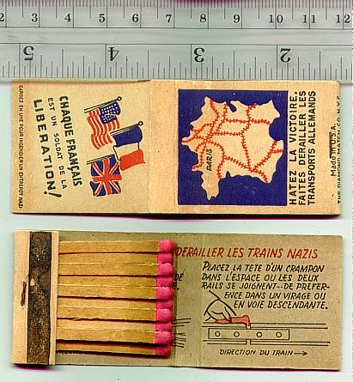
1. What symbols (if any) are used in the poster?
2. Is this piece of propaganda from the Axis or Allied side?
3. What is the illustrator trying to motivate people to do or believe? What purpose does this poster serve?
4. The most effective posters use symbols that are unusual, simple, and direct. Is this an effective poster? Why?

Slide 6
What symbols (if any) are used in the poster?
2. Is this piece of propaganda from the Axis or Allied side?
3. What is the illustrator trying to motivate people to do or believe? What purpose does this poster serve?
4. The most effective posters use symbols that are unusual, simple, and direct. Is this an effective poster? Why?

Slide 7
1. What symbols (if any) are used in the poster?
2. Is this piece of propaganda from the Axis or Allied side?
3. What is the illustrator trying to motivate people to do or believe? What purpose does this poster serve?
4. The most effective posters use symbols that are unusual, simple, and direct. Is this an effective poster? Why?

Slide 8
1. What symbols (if any) are used in the poster?
2. Is this piece of propaganda from the Axis or Allied side?
3. What is the illustrator trying to motivate people to do or believe? What purpose does this poster serve?
4. The most effective posters use symbols that are unusual, simple, and direct. Is this an effective poster? Why?

Slide 9
1. What symbols (if any) are used in the poster?
2. Is this piece of propaganda from the Axis or Allied side?
3. What is the illustrator trying to motivate people to do or believe? What purpose does this poster serve?
4. The most effective posters use symbols that are unusual, simple, and direct. Is this an effective poster? Why?

